Slide 1

Toodles – personal desktop assistant
User manual

Slide 2
Table of contents
Vote of Thanks
01
Student Introduction
02
Internship journey
03
About App
04
Contact information
05

Slide 3
Vote of thanks
I would like to thank my parents, my mentors – Ms Smita and Ms Shivani, Mr Ken, all my group members and YouTube channels that have helped me in successfully completing this project on time and gaining so much knowledge.

Slide 4
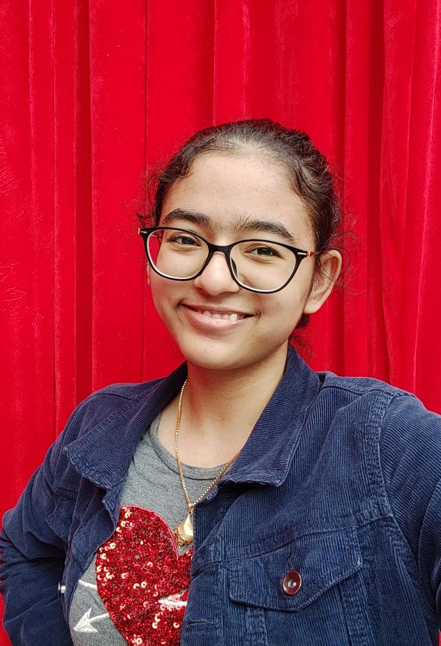
Student introduction:
I am Freya Khanna, a 16 year old girl currently studying in grade 11.
I have a deep interest in the field of Computer Science and Artificial Intelligence and aspire to be a software engineer.

Slide 5

Internship experience
I've had an amazing experience in the internship so far. It has been an amazing learning opportunity in which I have come across many concepts that have helped me in expanding my knowledge in the field of artificial intelligence and computer science.
So far, I have earned three rockstar badges.

Slide 6
About app
Toodles is a personal assistant built for your desktop.
It can assist you in:
Automatically opening Google
Providing summaries on any topic from Wikipedia
Opening YouTube
Telling you the time
Opening Gmail and sending emails
Performing any web search
Telling any jokes
Making and keeping track of notes

Slide 7
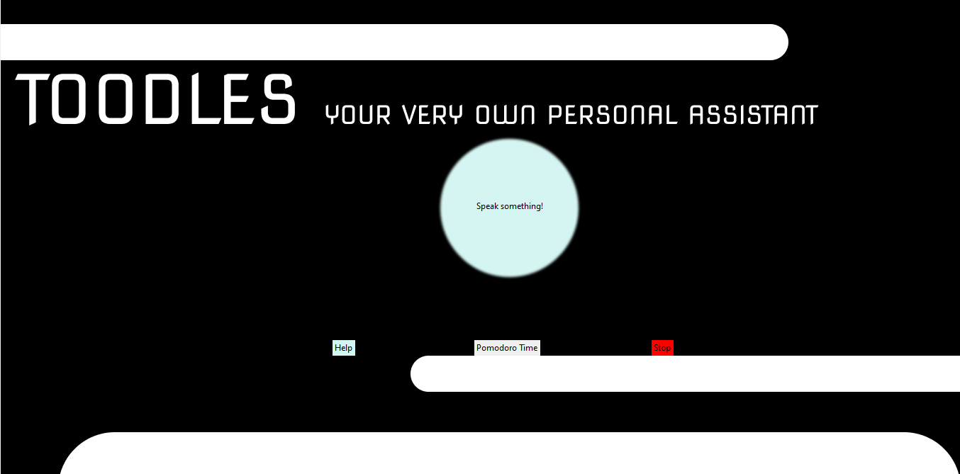
How do I use this app?
This is the first screen you see when you open the app. To use this app, you must click on the button that says, "Speak something!" Every time you wish to give the assistant a command. Once you do, viola, your wish is granted!

Slide 8
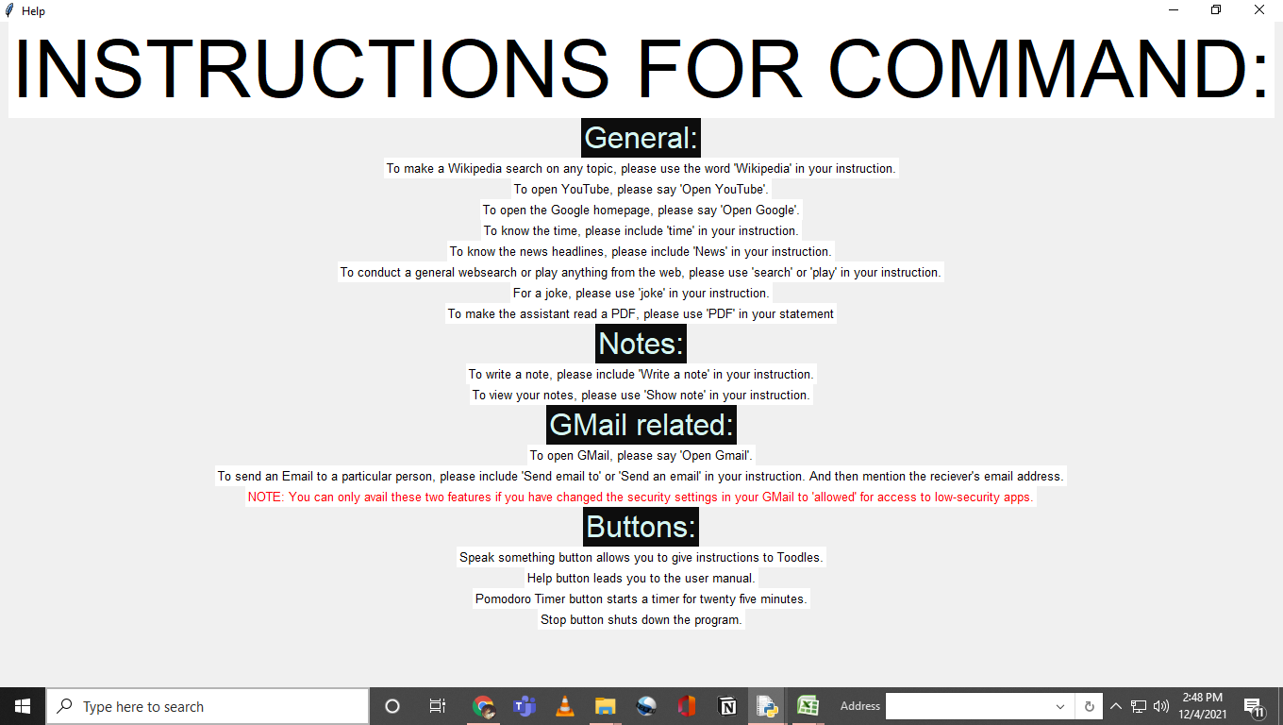
The 'Help' button leads you to a page with instructions.

Slide 9

Contact person
For any doubts, concerns and suggestion regarding the app, please reach me, Freya Khanna at freyakhanna2005@gmail.com

Slide 10

Thank you

